Slide 1
Presenting The Untapped Mid Ulster Tour
A collaboration between Loughlin Sholin and Croga Tours Ltd

Slide 2
Who we are
Loughin Sholin are the tourism cluster that represents the Mid Ulster area in the North of Ireland. They are made up of around 14 members that include Tourist attractions, Hotels, Bar and Restaurants and accredited tour guides
Croga Tours Ltd are a brand-new tour company based in the mid Ulster region

Slide 3
Loughin Sholin Members

Slide 4
Ballyscullion Park House
Seamus Heaney HomePlace
Glenavon House Hotel
Lough Neagh Fishermans Co – Operative Society
Ardtara Country House
Walsh’s Hotel
Friels Bar – Famine and Folklore Experience
Brough Tours
J&K Coaches
Heaney Brewery
Taphouse Bar & Resutraunt
Bakehouse NI
Glenshane Sheepdog Experience
Riverbann Tours

Slide 5
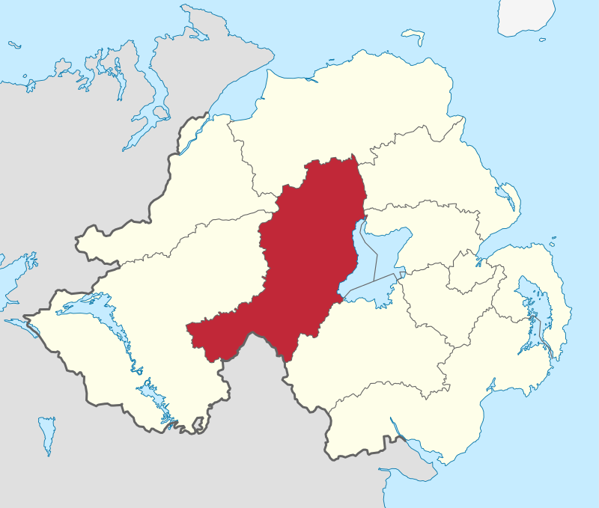
Where is Mid Ulster?
Mid Ulster is a district in Northern Ireland shown on the map. Mid Ulster has great transport links between neighboring cities Belfast and Derry/Londonderry
Image sourced from: https://en.wikipedia.org/wiki/Mid_Ulster_(district)

Slide 6
Untapped Mid Ulster Tour Dates
April – 17th 18th 19th & 20th
May – 22nd 23rd 24th & 25th
June – 19th 20th 21st and 22nd
July – 17th 18th 19th & 20th
September – 3rd 4th 5th & 6th
September – 10th 11th 12th & 13th

Slide 7
Day One Itinerary
Arrival into Northern or Southern Ireland from your desired pickup location and luxury coach travel to your first attraction
Seamus Heaney HomePlace
Group Lunch and Traditional Irish Music session Taphouse Restaurant
Seamus Heaney Openground
Glenavon House Hotel check in
Group Dinner at Friels Bar & Restaurant

Slide 8
Seamus Heaney HomePlace
Semaus Henaey is recognised as one of the major poets of the 20th century and a native of Northern Ireland. This Exhibition discovers how his HomePlace in Bellaghy shaped his life and was a great source of inspiration throughout his career. Seamus Heaney HomePlace takes you on an inspiring Journey through the life and work of one of Irelands greatest writers. Recent winners of Tourism NI’s most innovative large businesses.

Slide 9
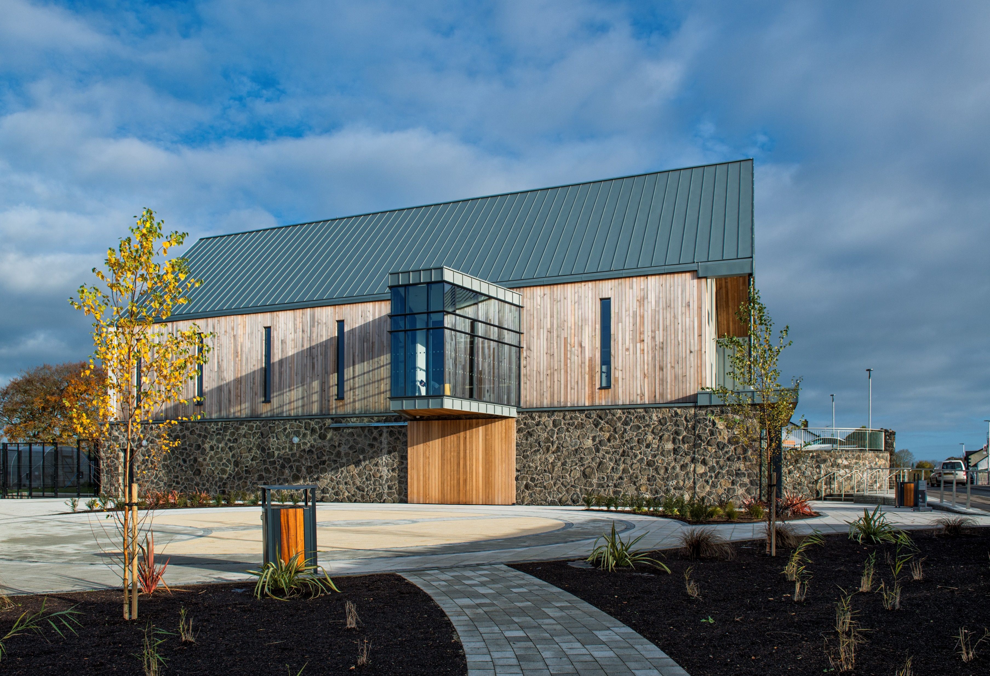
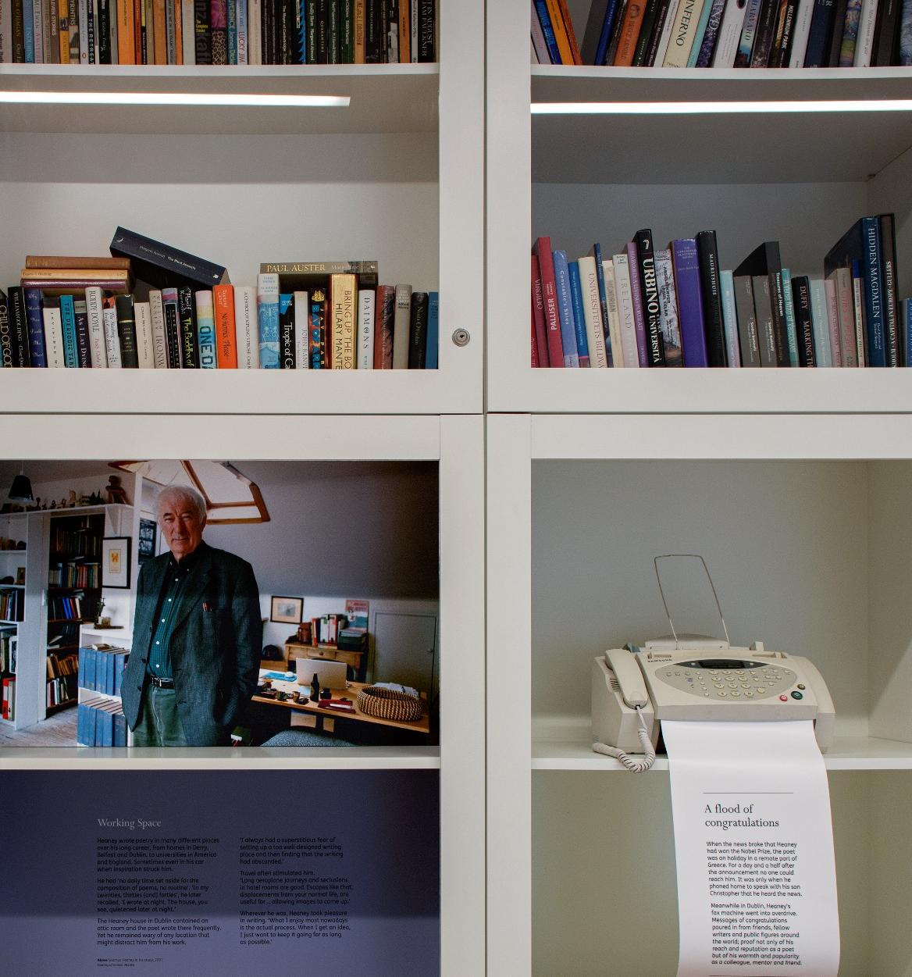

Slide 10
Taphouse Restaurant Bellaghy
The Taphouse Bar and Restaurant located within the historic town of Bellaghy is a stone throw away from Seamus Heaney HomePlace and Exhibition. Discover authentic Irish food with a group lunch with the backdrop of traditional Irish music in the groups own private room.

Slide 11
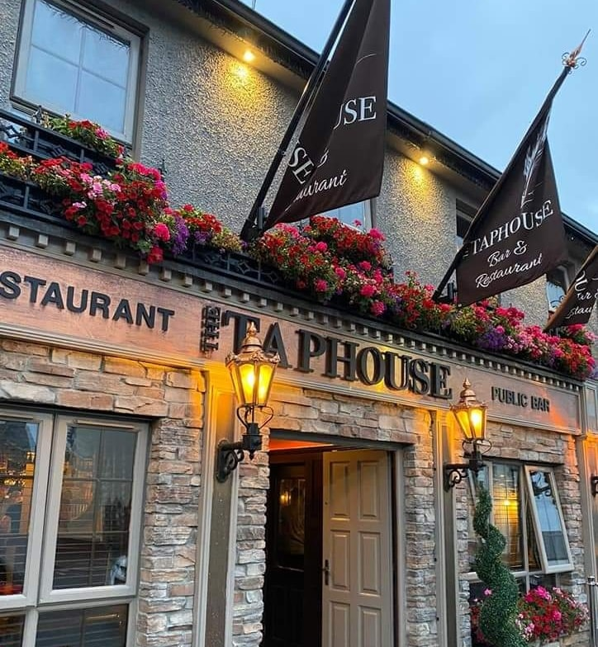
The Taphouse Bar & Restaurant Bellaghy

Slide 12
Seamus Heaney Openground
Openground is an authentic experience centred on five locations that inspired Seamus Heaney’s work. This is a natural extension of the homeplace offering. Influence by the rice legacy of his literature. In each location interpretation panels tell visitors about the places they are visiting. Experienced guides add an extra layer of interaction with the places and landscape where visitors hear directly how each of the five locations held great significance for Seamus Heaney’s writing.

Slide 13
Seamus Heaney Openground
Openground is an authentic experience centred on five locations that inspired Seamus Heaney’s work. This is a natural extension of the homeplace offering. Influence by the rice legacy of his literature. In each location interpretation panels tell visitors about the places they are visiting. Experienced guides add an extra layer of interaction with the places and landscape where visitors hear directly how each of the five locations held great significance for Seamus Heaney’s writing.

Slide 14
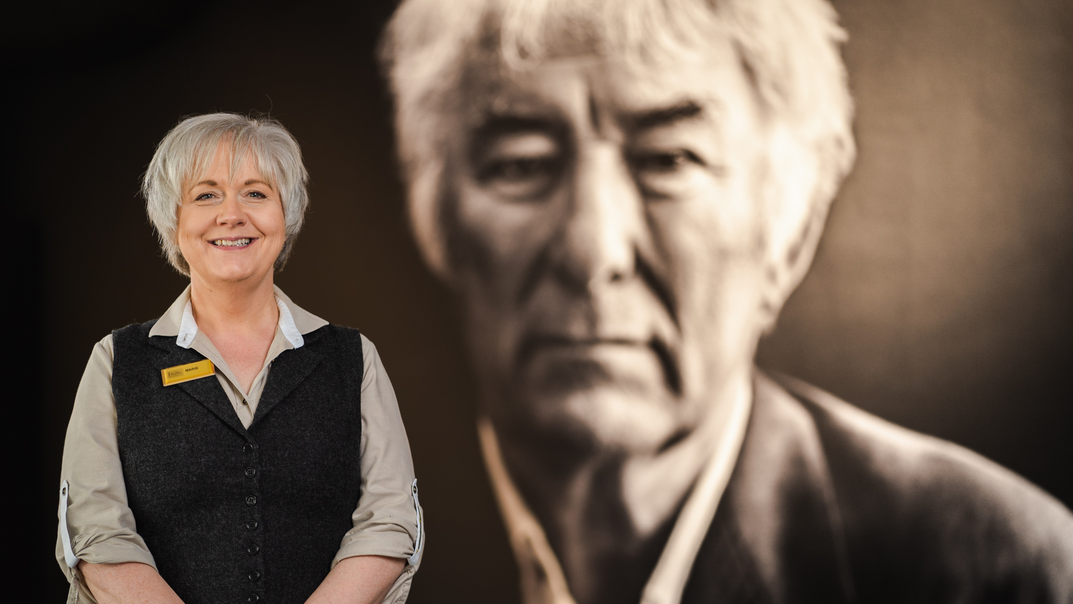
Seamus Heaney Openground

Slide 15
Glenavon House Hotel Cookstown
Check in and relax for the evening in Glenavon House Hotel Cookstown. Set in nine acres of mature groups this 3* Hotel offers first class comfort for all its guests

Slide 16
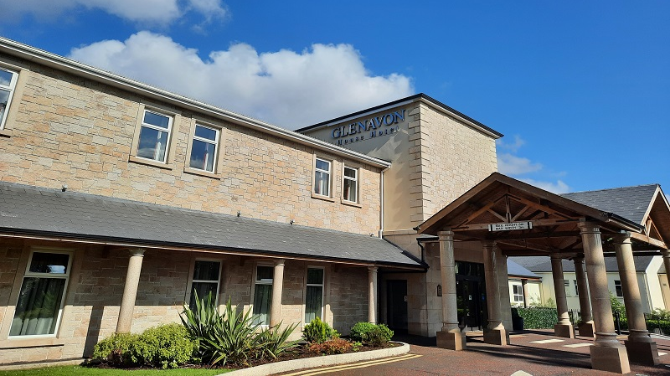
Glenavon House Hotel Cookstown

Slide 17
Friels Bar & Restaurant
Enjoy a group dinner on your first evening in this historic 5th generation family run bar & restaurant. Friels Bar & Restaurant. Nestled in the picturesqre village of Swatrea this bar has been in the family for over 100 years. This establishment has the original wooding ceiling and a roaring fire. The perfect way to end your first day in the untapped mid ulster.

Slide 18
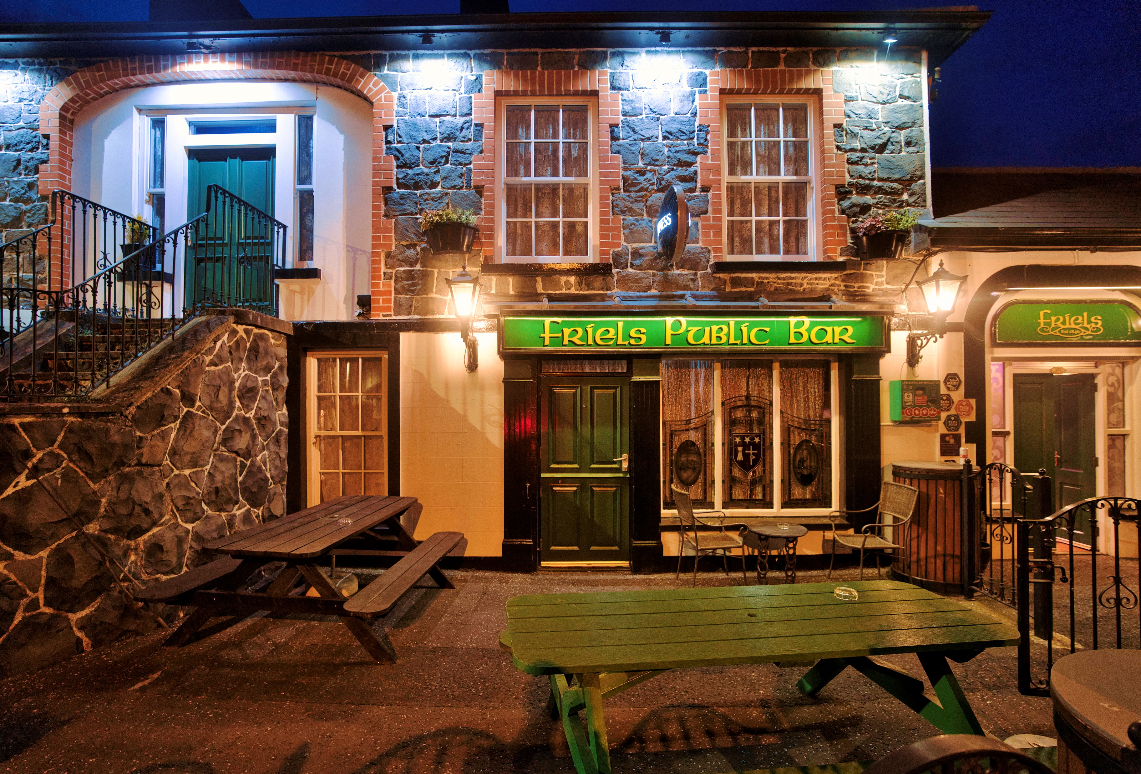
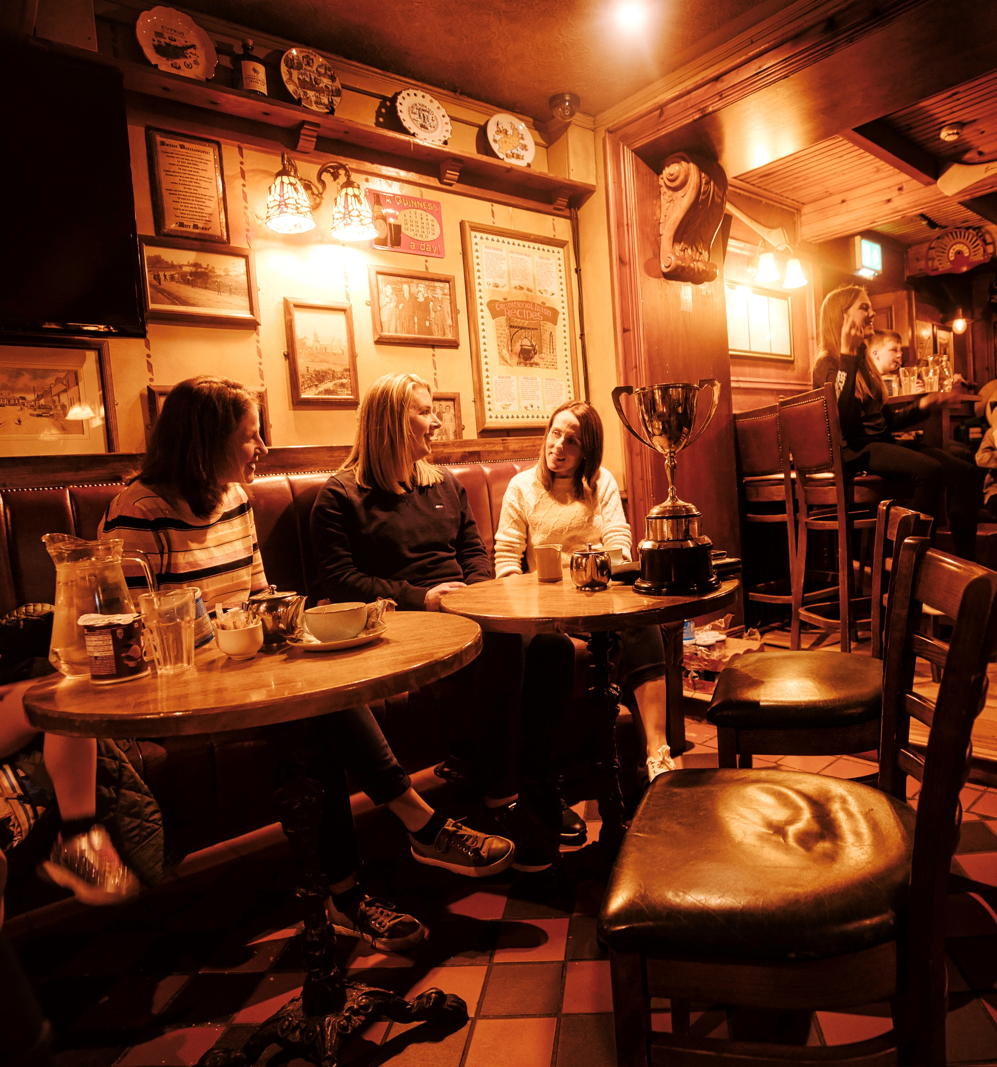

Slide 19
Day Two Itinerary
The Emigrants Tale
Beer Tasting with Heaney Farmhouse Brewery
Free time with your Tour Guides
Glenavon House Hotel Dinner

Slide 20
The Emigrants Tale (Option A)
Experience a walk in the footsteps of an Emigrant leaving famine-stricken Ireland. Local famine Expert Cathy will guide you up Carntogher Mountain where the famine struck emigrants walked their final footsteps on Irish Soil. You will place your own stone on the ‘Carn’ and soak up the stunning views of home that the emigrants took with when they last left Ireland.

Slide 21
The Emigrants Tale (Option B)
Alternatively, if you would like to take it a little easier, you can immerse yourself in the history and atmosphere of Friels, a 5th generation traditional pub. Sitting fireside, you will hear the Emigrants Tale from local historian and pub owner, Dermot Friel. Dermot will give you an emotive, yet uplifting, insight into the Irish Famine on the site of the original famine soup kitchen. You will also hear local folklore of the characters who have shaped the bar in its 180 year history, including poet, traveller and adventurer Mick McAtamney and see his 100-year-old hand carved walking stick.

Slide 22
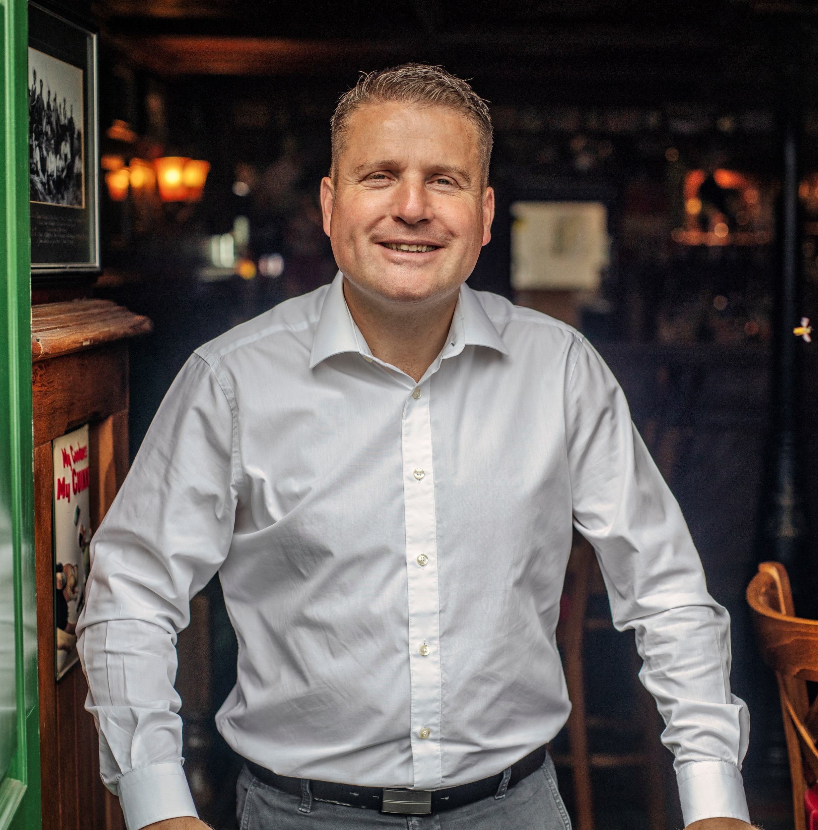
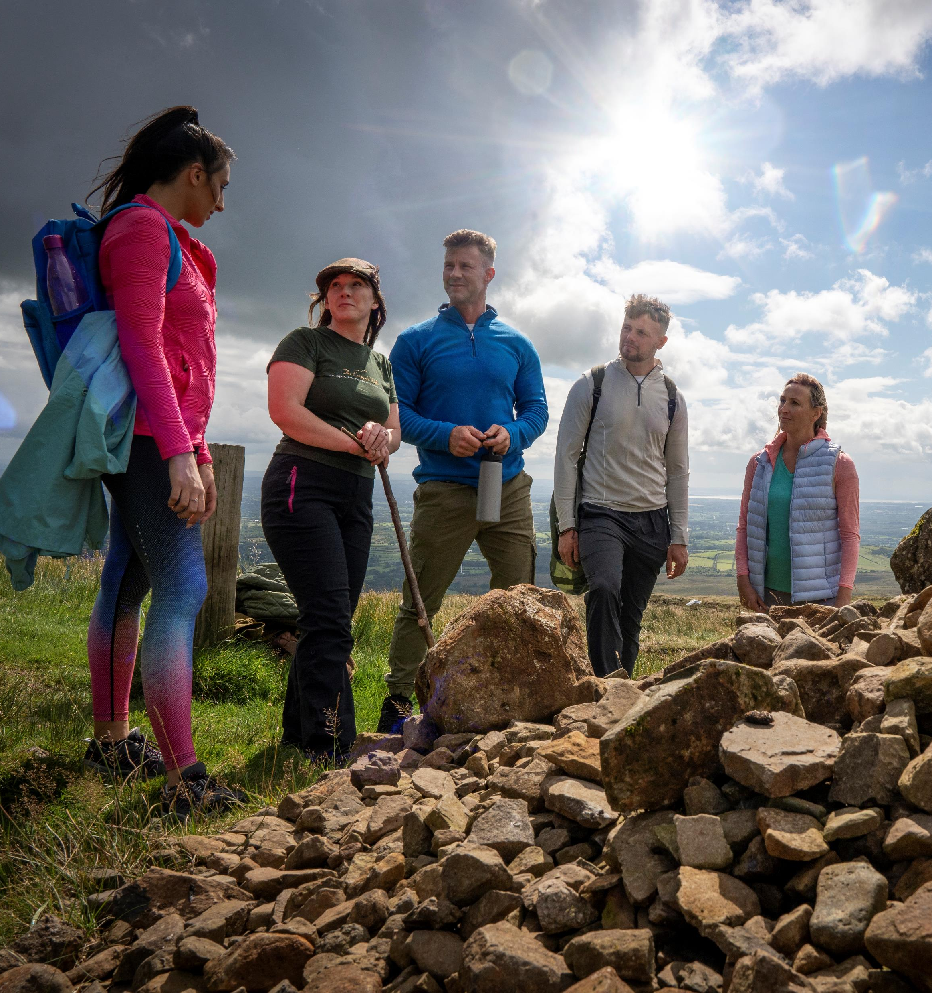
The Emigrants Tail with Cathy O’Neill & Dermott Friel

Slide 23
Heaney Farmhouse Brewery Tasting
Included in the Emigrants Tale is Lunch and Beer tasting in Friels Bar and Resutraunt. Meet local artisan beer brewer Suzanne Heaney from Heaney Farmhouse Brewery and enjoy a tasting and immersive experience, learning all that the brewery has to offer.

Slide 24
Day Three Itinerary
Glenshane Country Sheepdog Farm (Fleece to Fashion and fireside lunch)
Seasonal foraging and bread making session with Bronagh Duffin
Walsh’s Hotel Group Dinner

Slide 25
Glenshane Country Farm with Jamese McCloy
At the foothills of the spectacular Sperrin mountains meet forth generation sheep farmer Jamese McCloy as he demonstrates the centuries old skill of herding sheep.
Finish the demonstration with a fireside lunch which includes: Beautiful homemade soup, freshly made sandwiches, freshly baked traditional wheaten bread. Tea, coffee and biscuits.

Slide 26
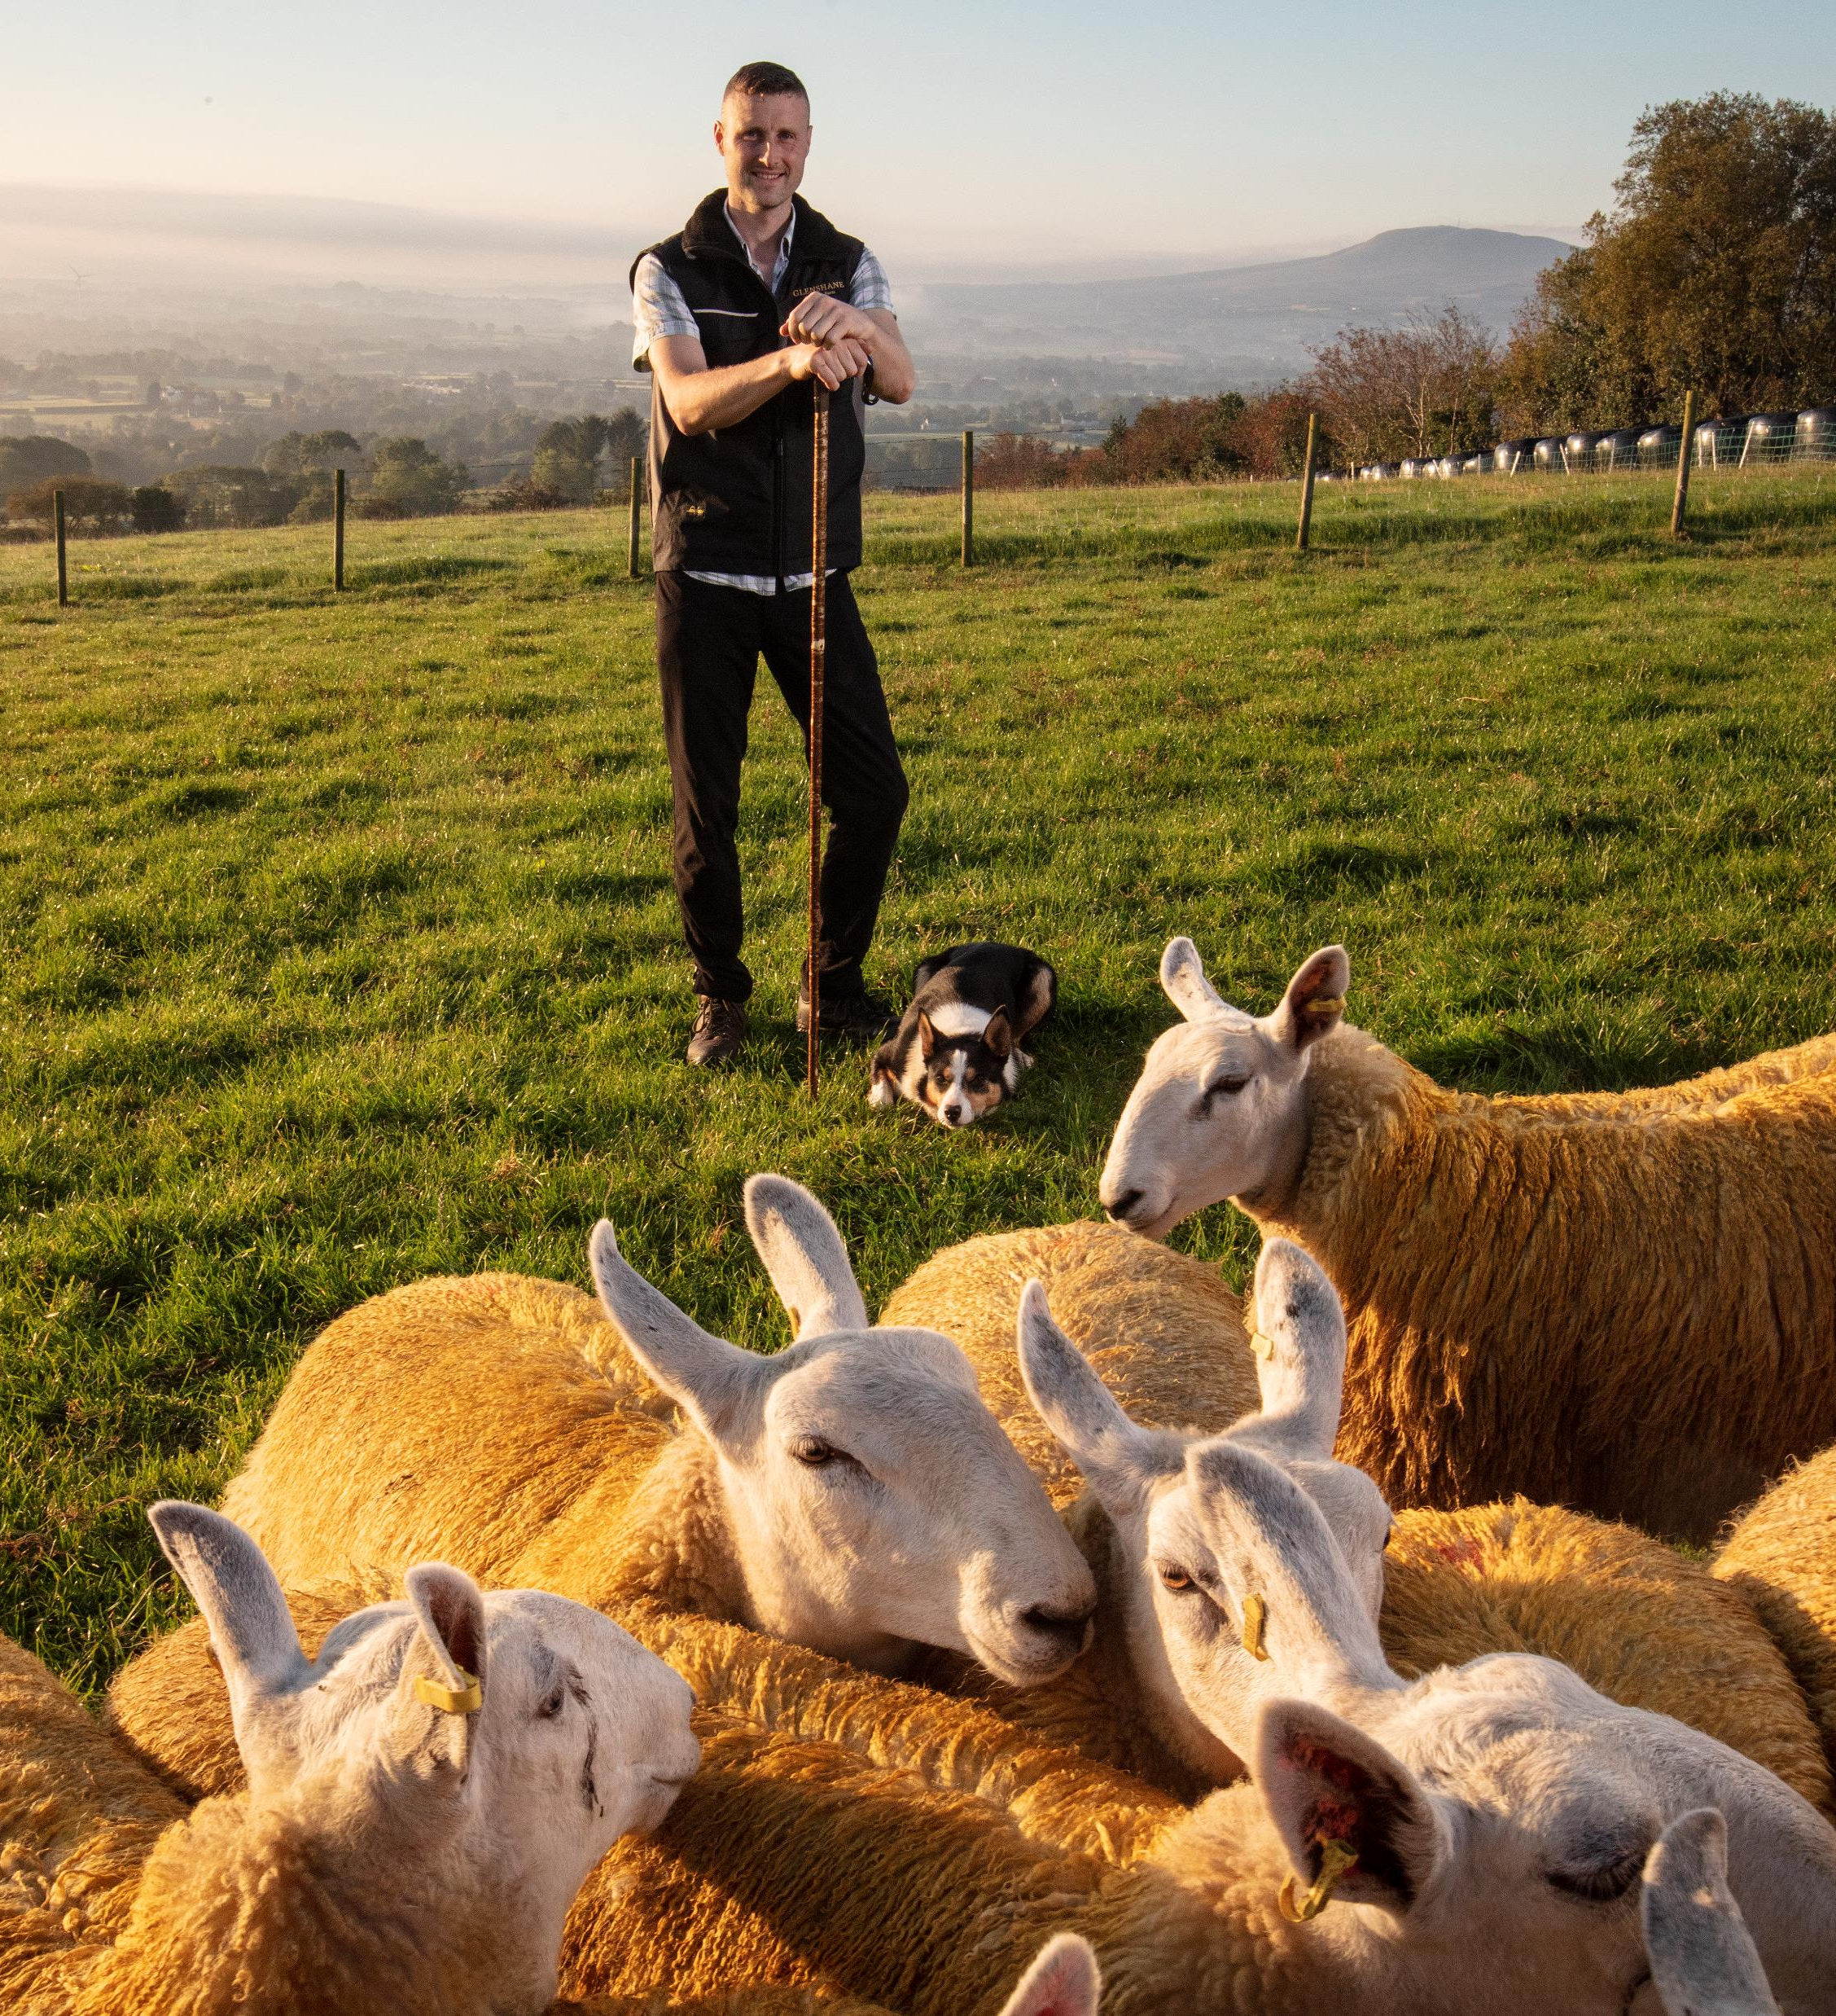
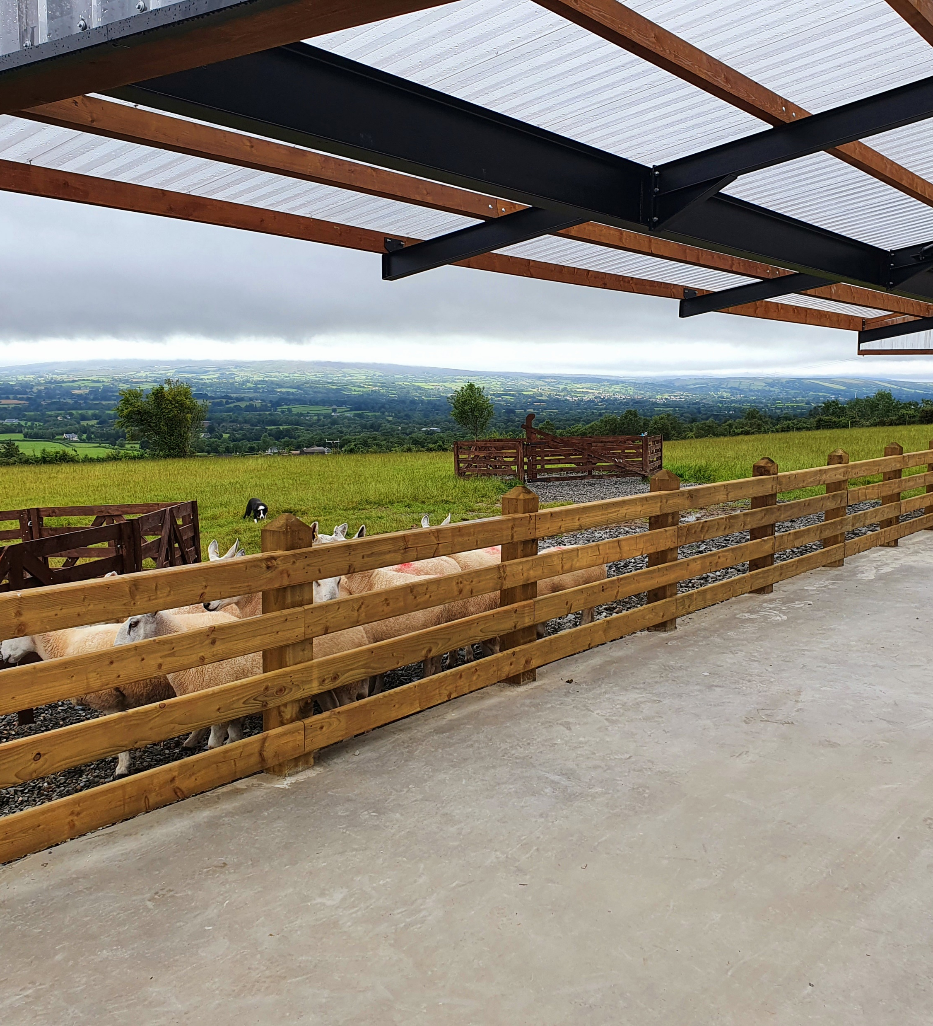

Slide 27
Seasonal Foraging and Bread Making
Enjoy an afternoon of seasonal foraging and bread making with Bronagh Duffin from Bakehouse NI Bronagh forages for Wild Garlic, Sloe’s for Gin, Elderflower dependent on the season and time of year. Finish the foraging with freshly made soda bread made by Bronagh

Slide 28
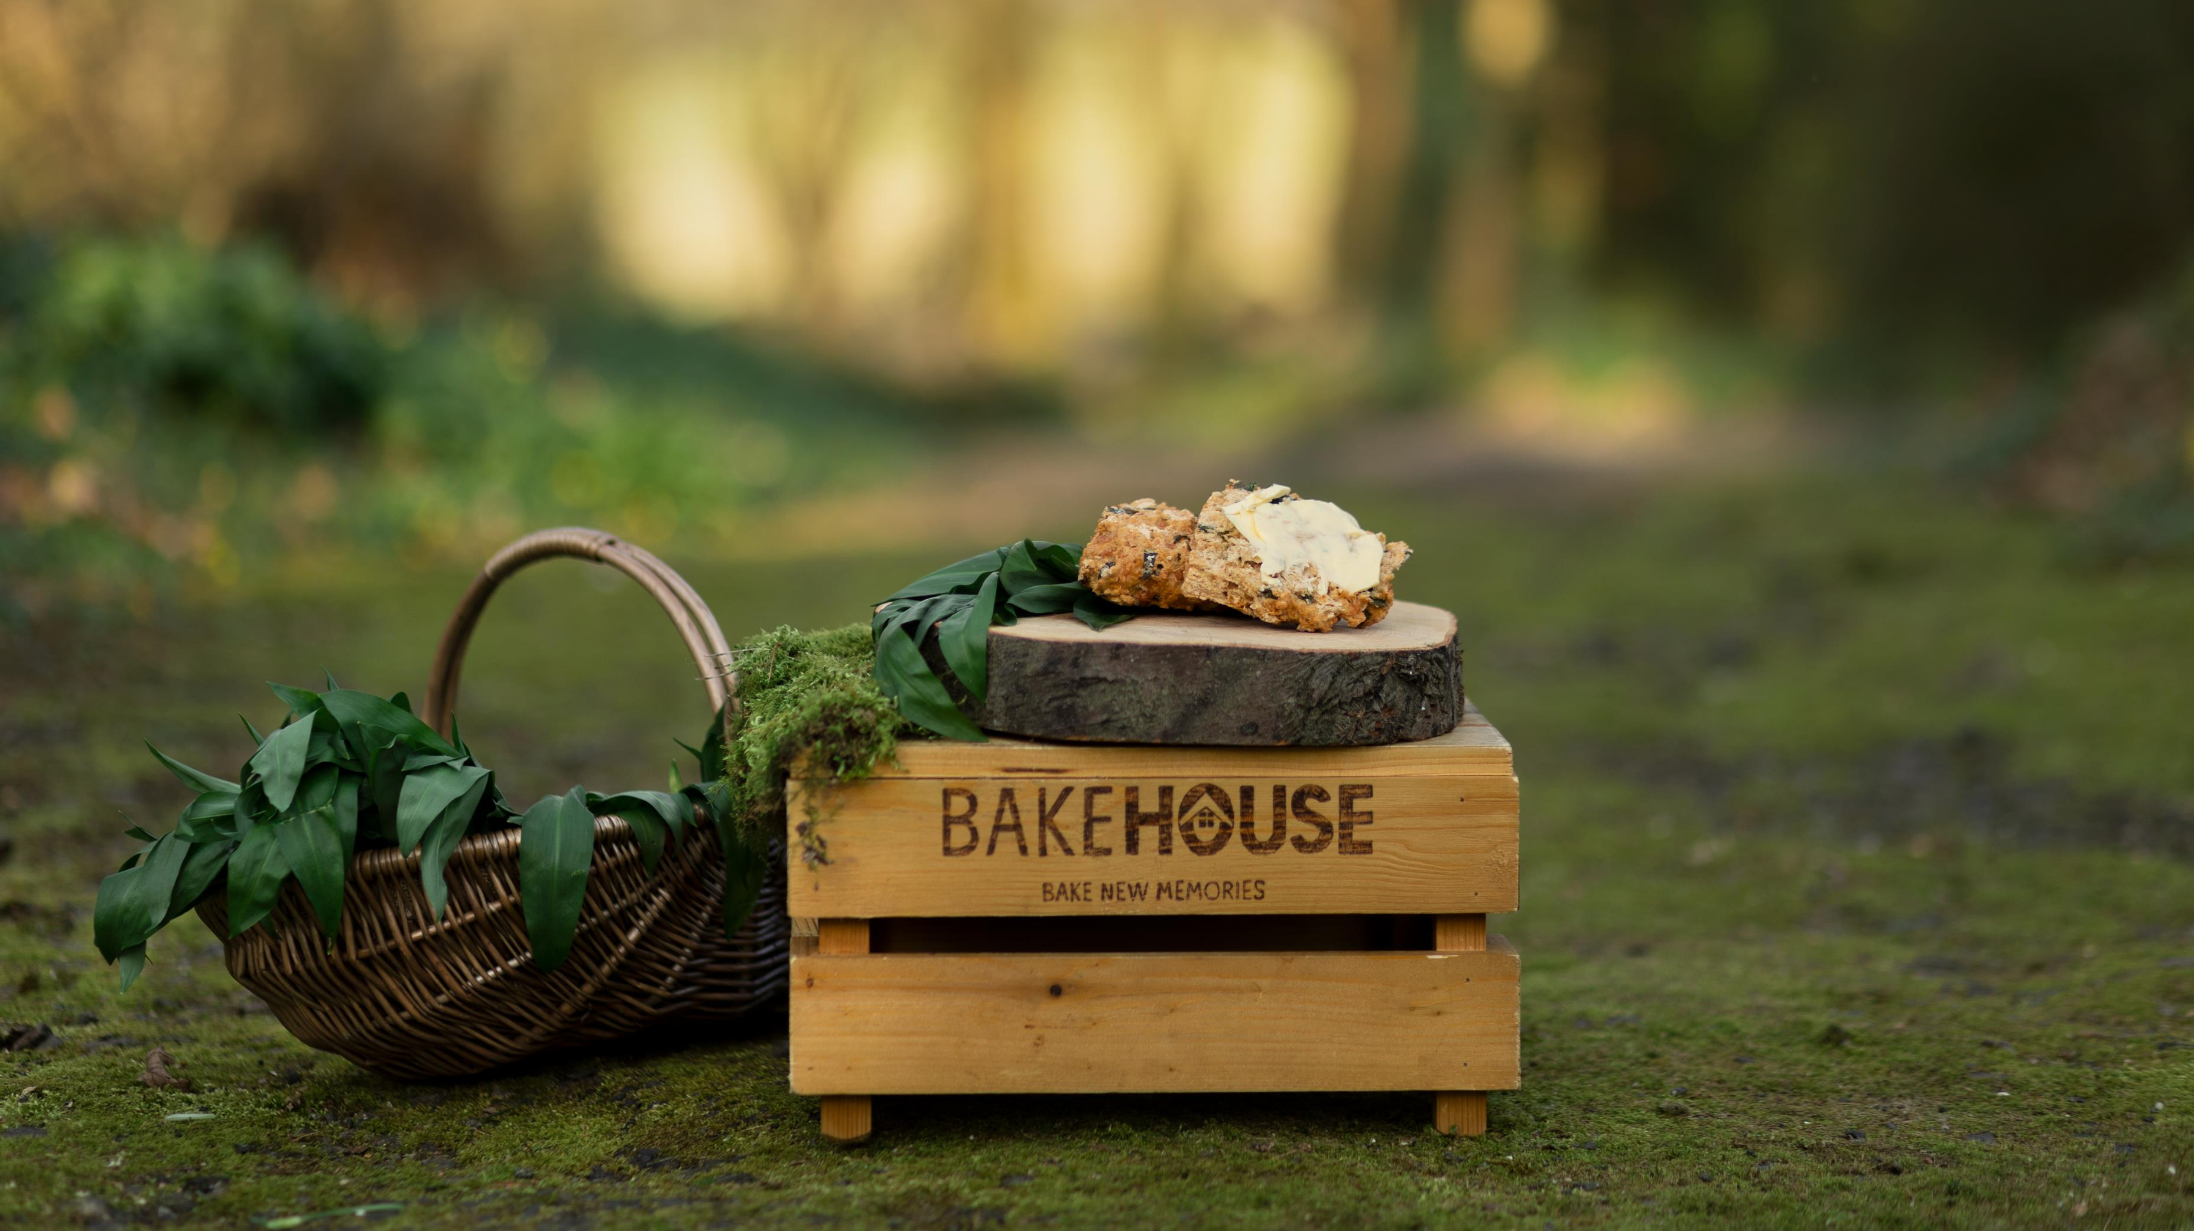
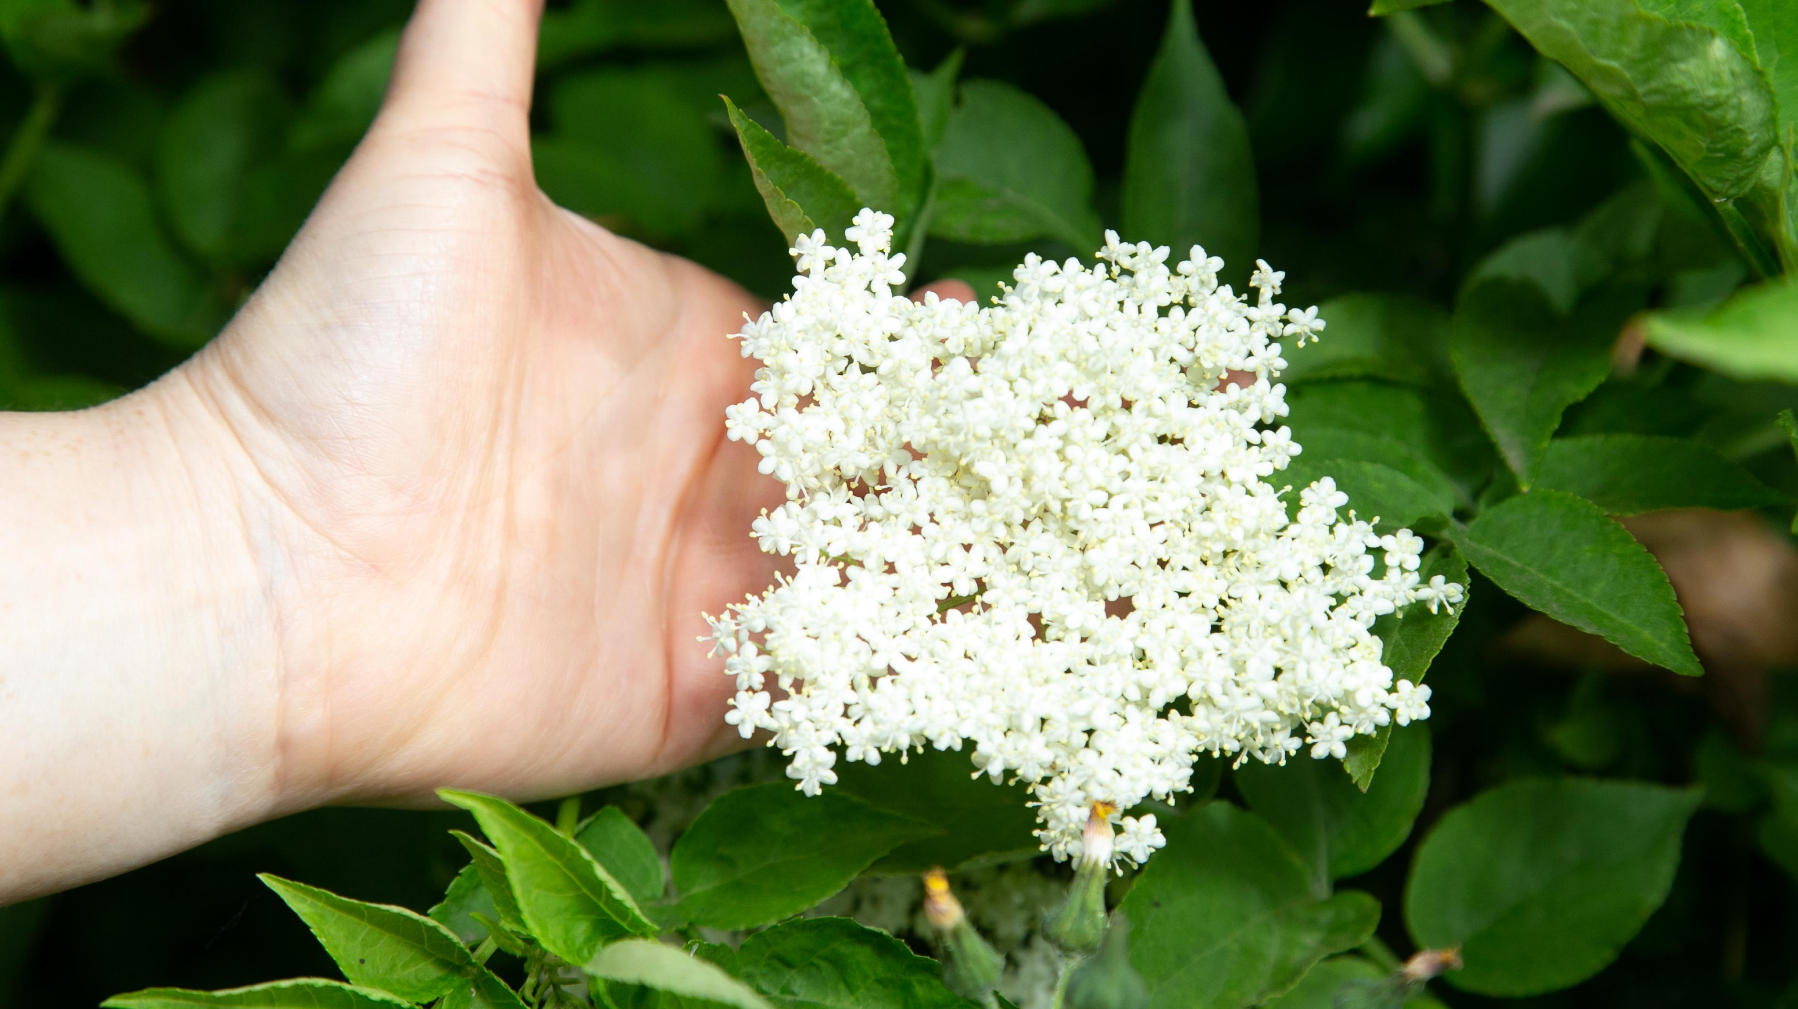
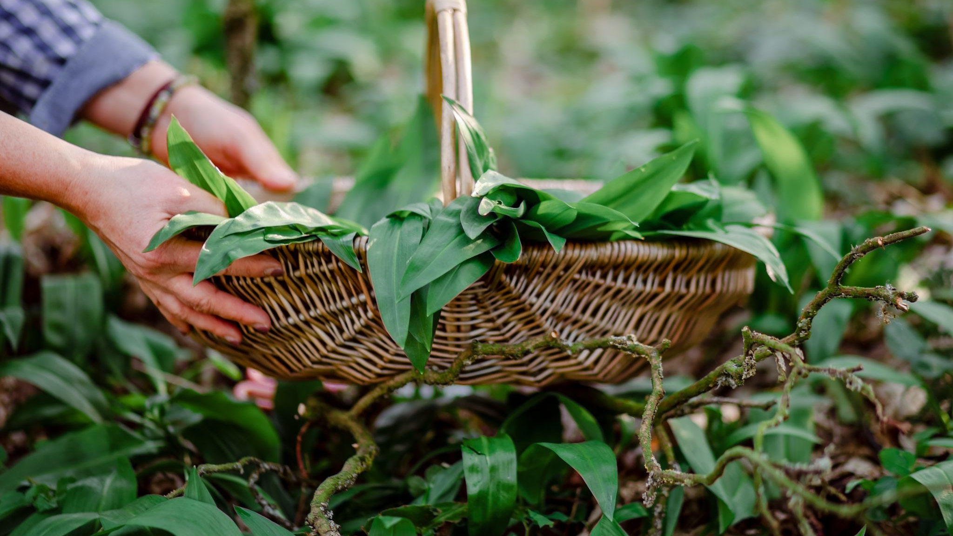
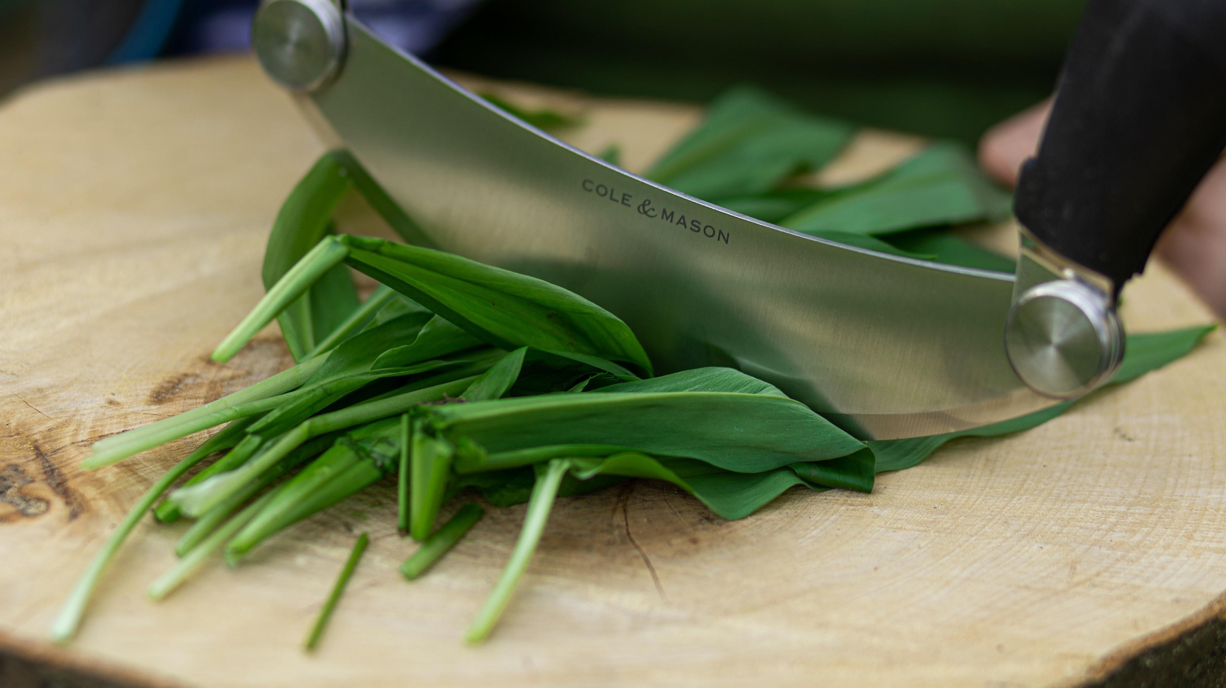

Slide 29
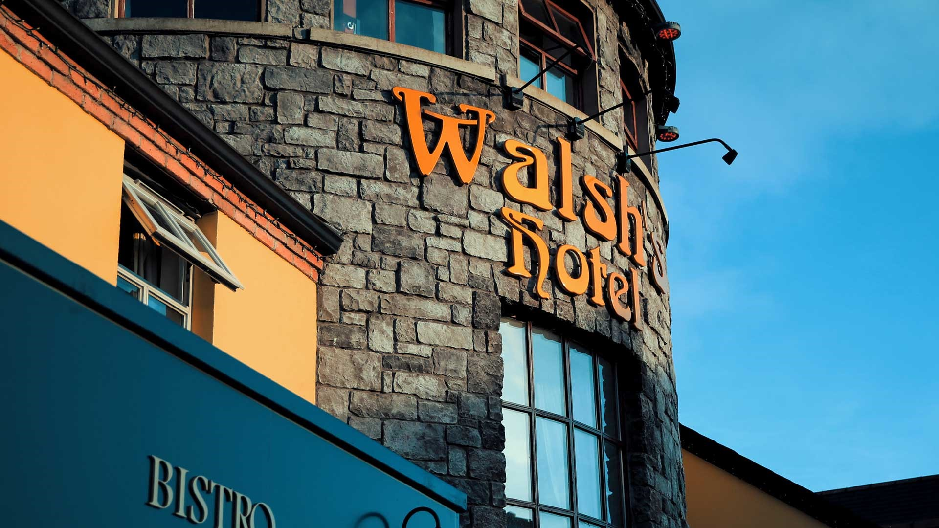
Walsh’s Hotel Group Dinner
Group evening dinner in Walsh’s Hotel Maghera. Walsh’s Hotel is a traditional countryside Hotel conveniently located between Belfast and Derry/Londonderry.

Slide 30
Day Four Itinerary
Riverbann Morning Boat Tour
Lough Neagh Fishery
Ardtara Country House Afternoon Tea
Group Departure

Slide 31
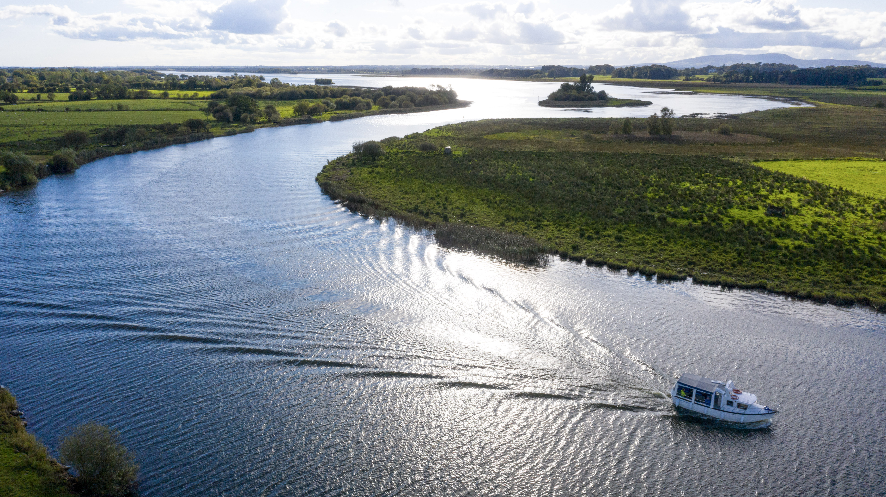
Riverbann Tours
Set sail on your last morning with us on Riverbann tours. This tour begins in Portglenoe and finishes in neighbouring Toome on the corner of Lough Neagh. Enjoy Tea, Coffee and tray bakes and enjoy this one-of-a-kind experience

Slide 32
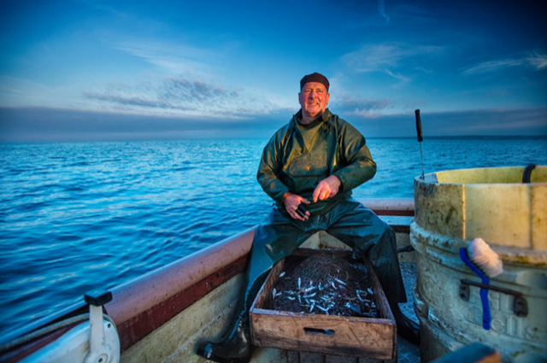
Lough Neagh Fishery
Lough Neagh is the home of one of the largest wild eel fishery in Europe. This visitor centre provides an informative insight into the fishing industry on the lough and the species that are found there

Slide 33
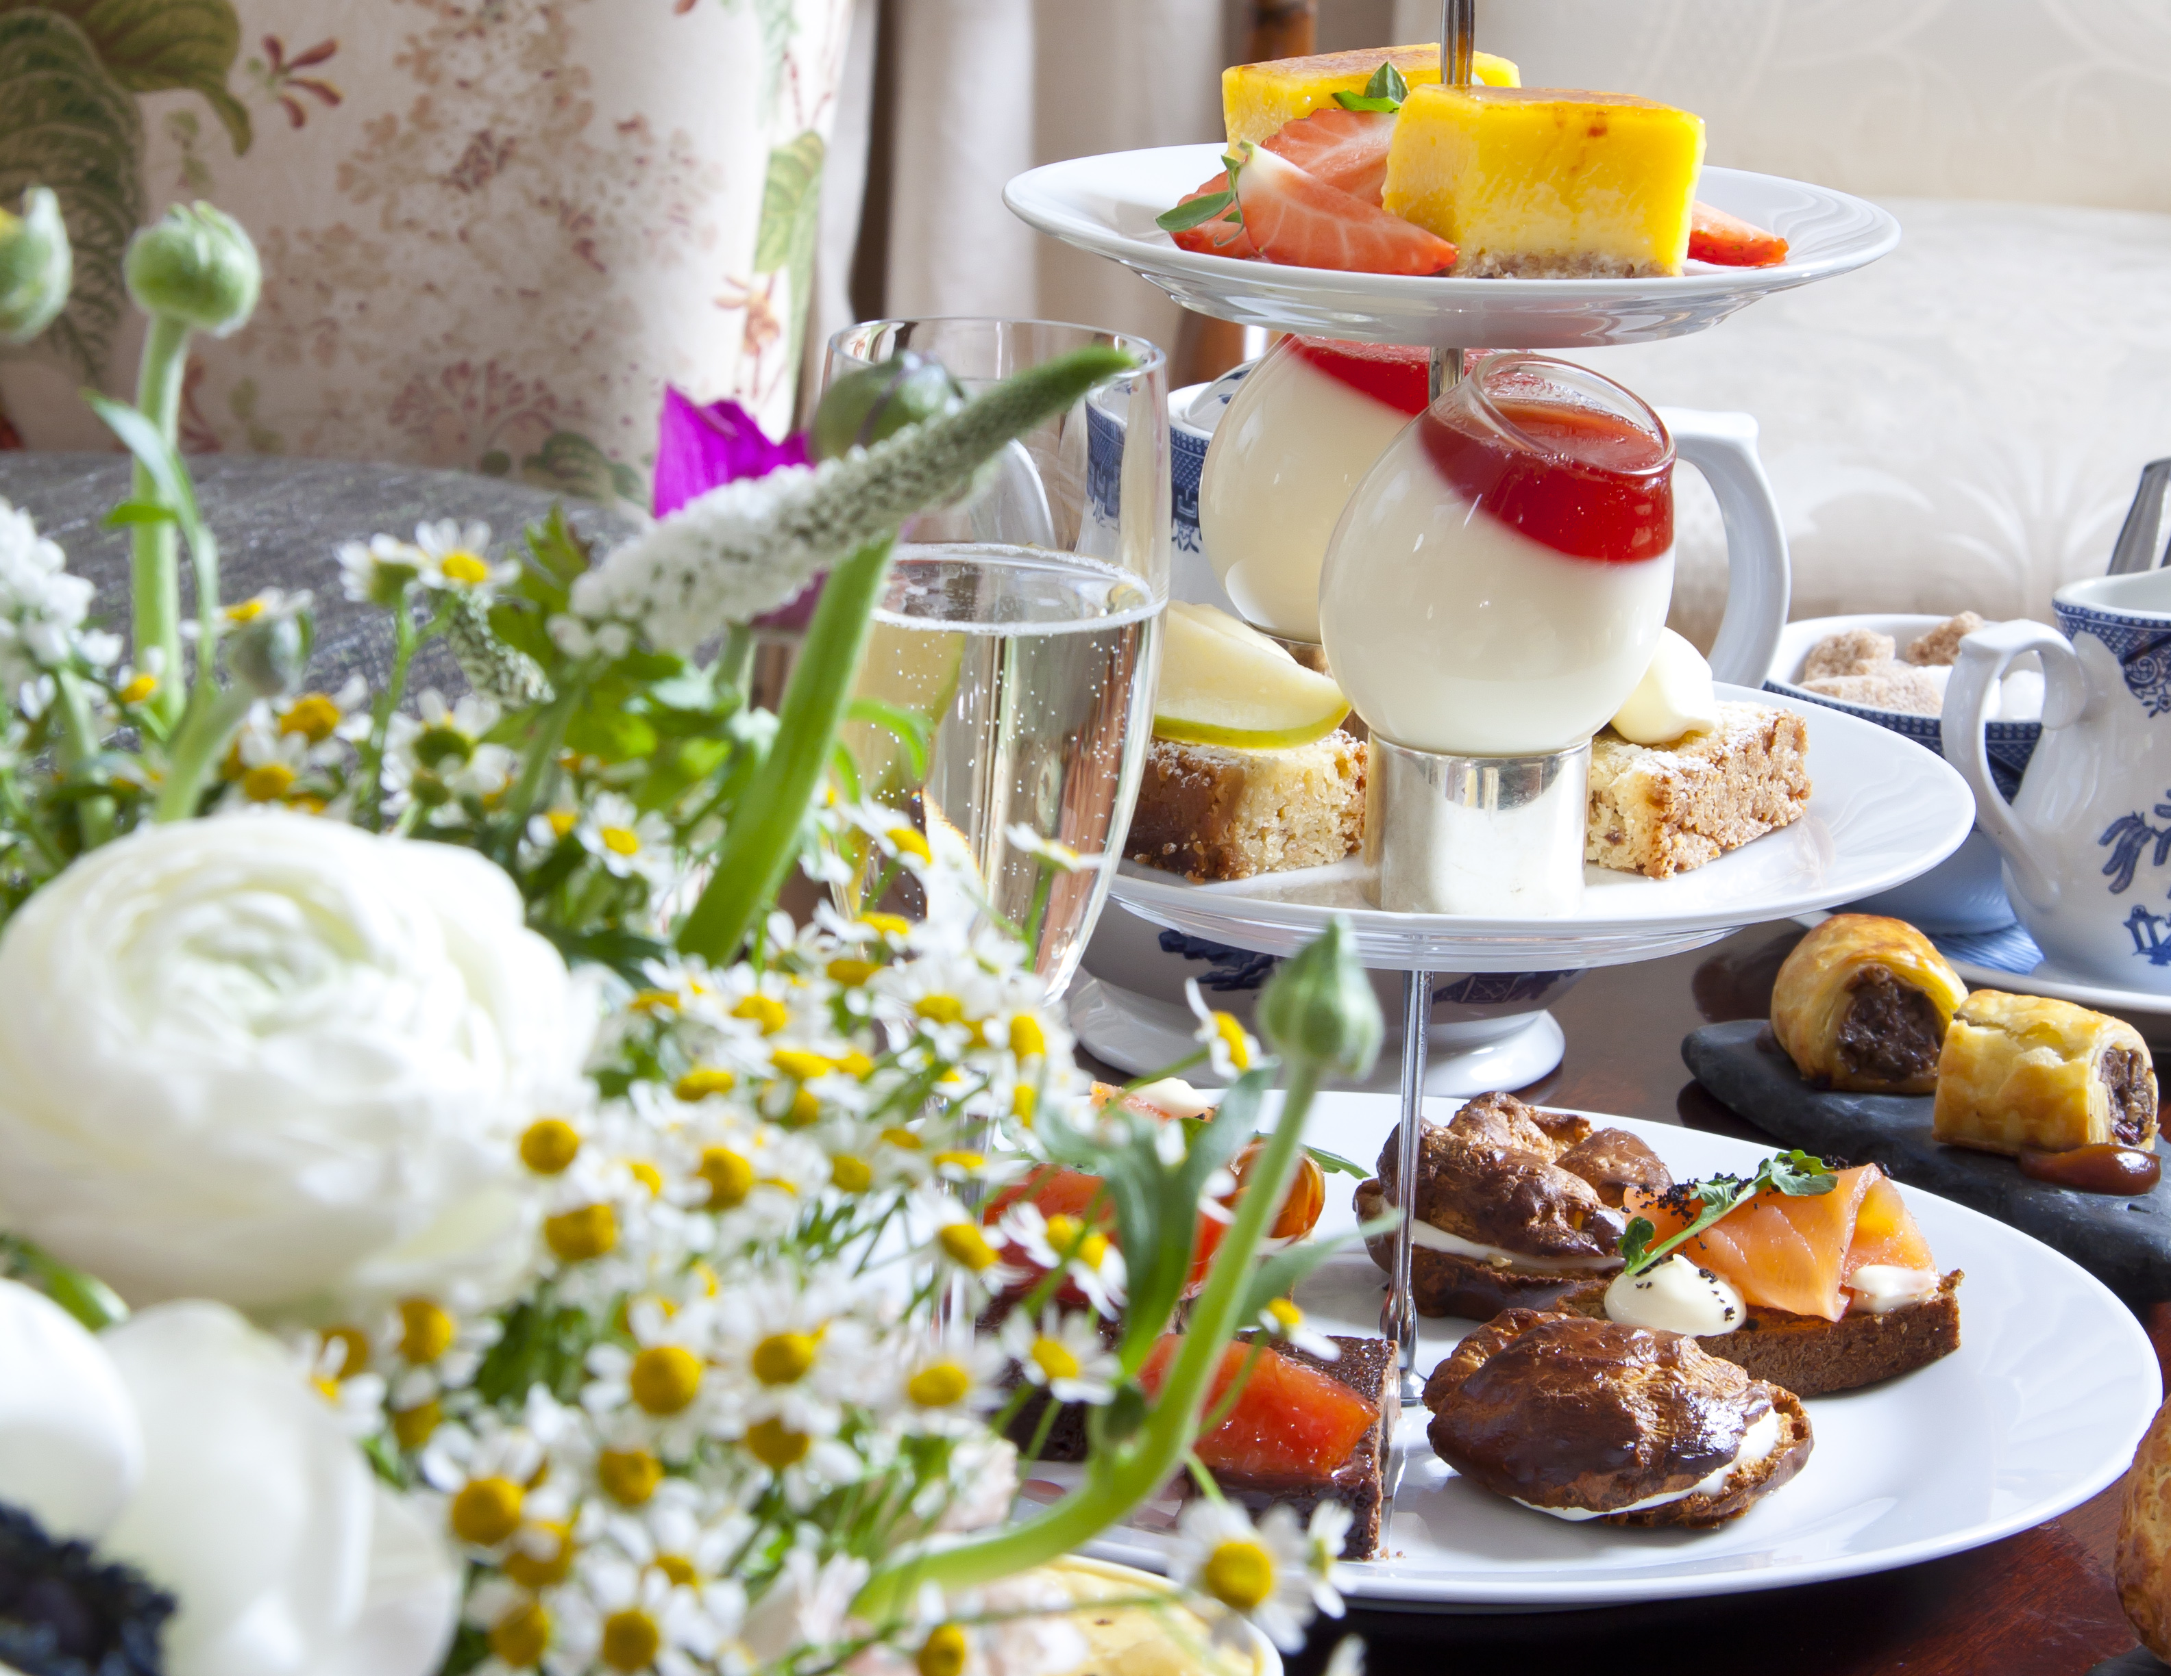
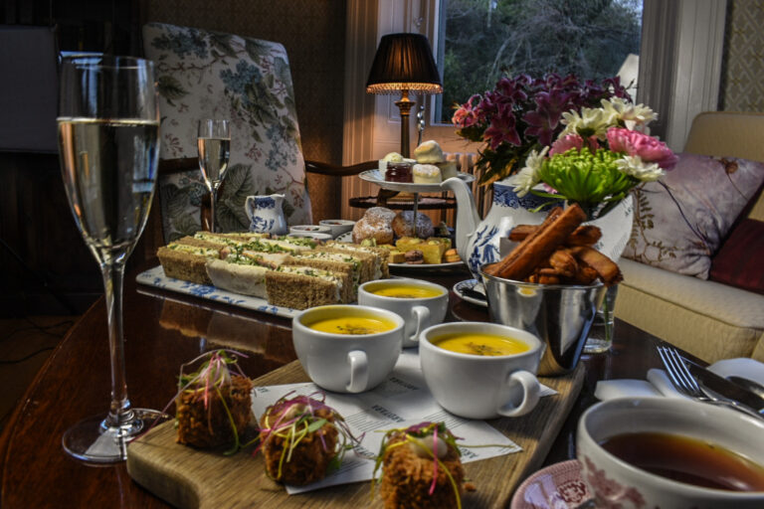
Ardtara House Afternoon Tea
For your final part of the tour. Enjoy a bespoke Afternoon Tea in the amazing grounds that are Artara House. This house dates back to 1896 and is an important part of Irish History, Enjoy your last activity as a group before your departure.

Slide 35
Untapped Mid Ulster Tour Pricing
Prices for this tour include:
Luxury Coach Transportation for the duration of the tour
3 x Night accommodation (Bed and Breakfast rate)
Entrance/Admission to all attractions and activities
Lunch and Dinner each day
Experienced Tour guides for four days tour
Price based on two people sharing | Price for Single person only
£595.00 per person | £647.50 per person

